Slide 1
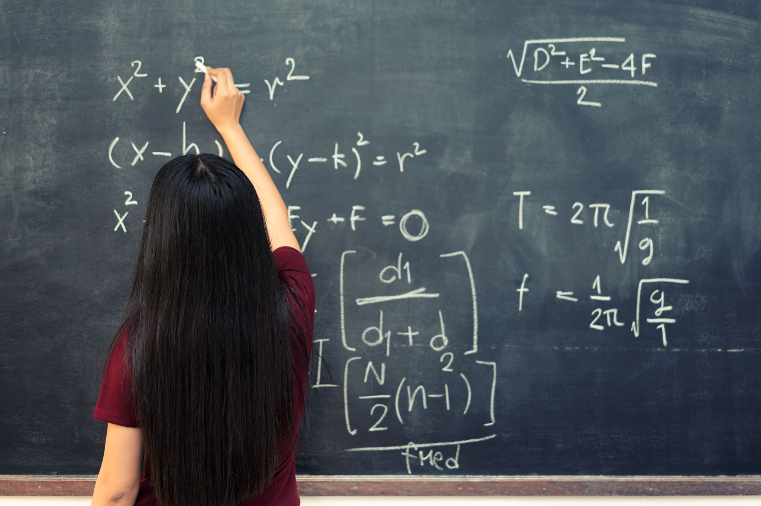
Simple Equations
HARSHA S VIJAYAKUMAR

Slide 2
Solve the following equations for x
1)6x-27+3x=4+9-x
A.4 B.5 C.6 D.-4
2)19(x+y)+17=19(-x+y)-21
A.-1 B.-2 C.-3 D.-4

Slide 3
Solve the following equations for respective values of x and y
1)3x+8y=30 and 6x-y=9
A.3,2 B.2,3 C.4,2 D.2,5
2)2x+5y=20 and 5x+6y=37
A.15,-2 B.5,2 C.-5,6 D.2,5
1)51x+49y=251 and 49x+51y=249
Solve the following equations for y
A.3 B.2 C.4 D.1

Slide 4
1)The cost of 16 pens and 8 pencils together is Rs.352 and the cost of 4 pens and 4 pencils together is Rs.96. Find the cost of each pen?
A.32
B.28
C.36
D.20

Slide 5
2)The cost of 2 chairs and 3 tables is Rs.1300.The cost of 3 chairs and 2 tables is Rs.1200.Then the cost of each table is more than that of each chair by_____
A.50
B.70
C.60
D.100

Slide 6
3)The denominator of a fraction is 1 less than twice the numerator. If the numerator and denominator are both increased by 1, then the fraction becomes 3/5.Find the fraction?
A.2/3
B.3/5
C.4/7
D.5/9

Slide 7
4) Three times the first of three consecutive odd integers is 3 more than twice the third. The third integer is:
A.9
B.11
C.13
D.15

Slide 8
5) A two-digit number is such that the product of the digits is 8. When 18 is added to the number, then the digits are reversed. The number is:
A.18
B.24
C.42
D.81

Slide 9
6) The sum of the digits of a two-digit number is 15 and the difference between the digits is 3. What is the two-digit number?
A.69
B.78
C.96
D.Cannot be determined
E.None of these

Slide 10
7)The sum of ages of 5 children born at the intervals of 3 years each is 50 years. What is the age of the youngest child?
A.4 Years
B.8 Years
C.10Years
D.12 Years

Slide 11
8) Father is aged three times more than his son Ronit. After 8 years, he would be two and a half times of Ronit's age. After further 8 years, how many times would he be of Ronit's age?
2 times
2.5 times
3 times
3.5 times

